Slide 1

Dr. NTR UNIVERSITY OF HEALTH SCIENCES VIJAYAWADA, ANDHRA PRADESH MDS PRACTICAL EXAMINATION –SEPTEMBER 2020
GOVERNMENT DENTAL COLLEGE AND HOSPITAL
DEPARTMENT OF PERIODONTICS AND IMPLANTOLOGY
HT .NO: 18D315011003

Slide 2
MAJOR CASE PRESENTATION

Slide 3
Demographic data
Name: P. Sowjanya
Age: 29 yrs
Sex: Female
OPD no.: Jun 27.3
Occupation: Home maker
Address: Rajampeta

Slide 4
Chief complaint: Patient complaints of painful and bleeding gums since 2 years.
History of present illness : History of painful and bleeding gums from 2 years. Bleeding gums noted while brushing and biting on hard food and sometimes spontaneously.

Slide 5
Past dental history: History of oral prophylaxis 1 year back and underwent extraction of 46 1 year back due to caries.
Medical history : No Relevant Medical History
Family history: No Relevant Family History

Slide 6
Oral hygiene habits:
Type: Medium
Direction: Horizontal scrubbing
Duration: 5 minutes
Dentifrice: Non medicated
Frequency: Once daily in the morning
Dietary habits: Mixed

Slide 7
General examination: Conscious, coherent, cooperative and well oriented.
Extraoral examination:
Symmetry: Apparently symmetrical
Lymph nodes: Not palpable
TMJ: No Abnormality Detected
Lip seal: Competent

Slide 8
INTRAORAL EXAMINATION
Labial mucosa: No Abnormality Detected
Buccal mucosa: No Abnormality Detected
Tongue: No Abnormality Detected
Palate: No Abnormality Detected
Floor of the mouth: No Abnormality Detected

Slide 9
Halitosis: Absent
ORAL HYGIENE STATUS:
OHI-S=D.I-S+C.I-S
2+2=4 POOR ORAL HYGIENE
16 | 11 | 26
2 | 2 | 2
2 | 2 | 2
47 | 31 | 36
16 | 11 | 26
2 | 2 | 2
2 | 2 | 2
47 | 31 | 36

Slide 10
Periodontal index:(Russell A.L 1956) P.I SCORE PER PERSON= SUM OF INDIVIDUAL SCORE/NO.OF TEETH PRESENT=158/31=5.09 (TERMINAL DISEASE)
6 | 6 | 6 | 6 | 6 | 6 | 6 | 6 | 6 | 6 | 6 | 6 | 6 | 6 | 6 | 6
8 | 7 | 6 | 5 | 4 | 3 | 2 | 1 | 1 | 2 | 3 | 4 | 5 | 6 | 7 | 8
2 | 6 | M | 2 | 2 | 2 | 6 | 6 | 6 | 6 | 2 | 6 | 6 | 6 | 2 | 2

Slide 11
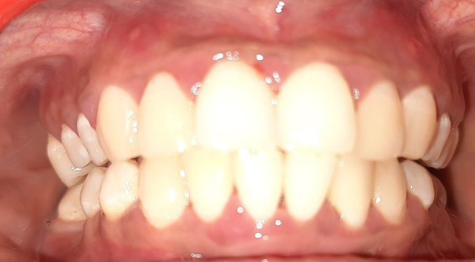
GINGIVAL STATUS
Color: Generalized erythematous marginal and interdental & attached gingiva.

Slide 12
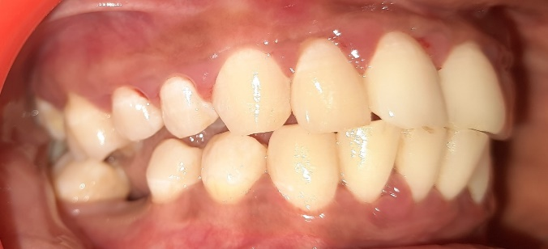
Consistency: Generalized soft and edematous
Contour: Diminished scalloping with rounded edges.
Size: Generalized mild gingival enlargement of interdental papilla is seen.

Slide 13
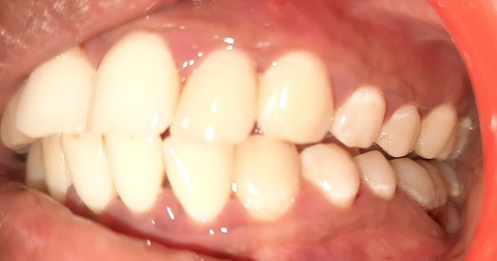
Surface texture: Generalized loss of stippling.
Position: No alterations in position

Slide 14
Bleeding on probing: Generalized
Exudation: Generalized purulent exudate present.

Slide 15
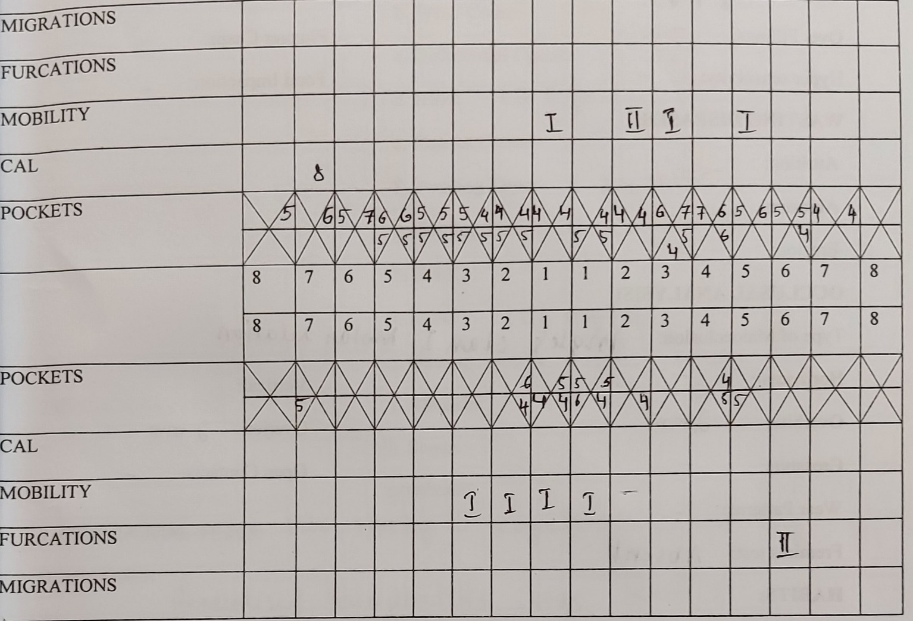
PERIODONTAL STATUS

Slide 16
Mobility:
Grade I irt 31,32,41,11,23,25.
Grade II irt 22

Slide 17
Width of attached gingiva: Adequate
Depth of vestibule: Adequate
Frenal attachment:
Maxillary: Mucosal
Mandibular: Mucosal
Tension test: Negative
Millers Class I Recession irt 17

Slide 18
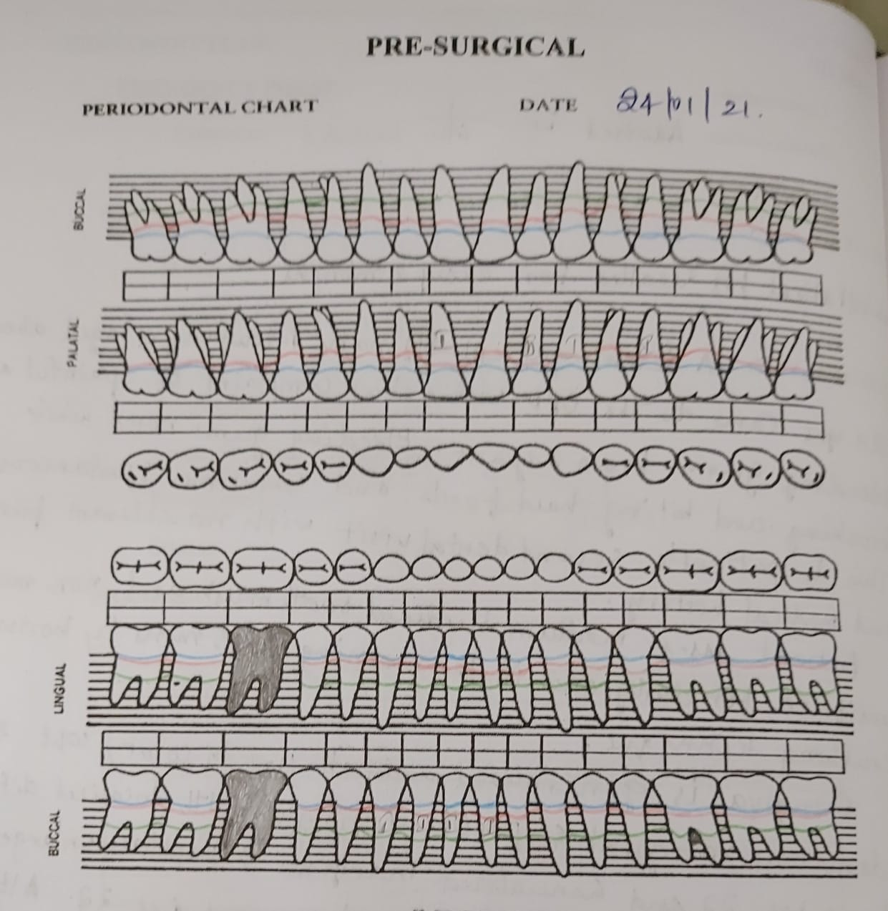
PRESURGICAL CHARTING

Slide 19
Dental status:
Number of teeth: 31
Caries: 48, 36.
Missing teeth: 46

Slide 20
Occlusal analysis:
Type: Angles class 1 malocclusion
Overbite: 2mm
Overjet: 2mm

Slide 21
Provisional diagnosis: Generalized Periodontitis stage III, grade B.

Slide 22
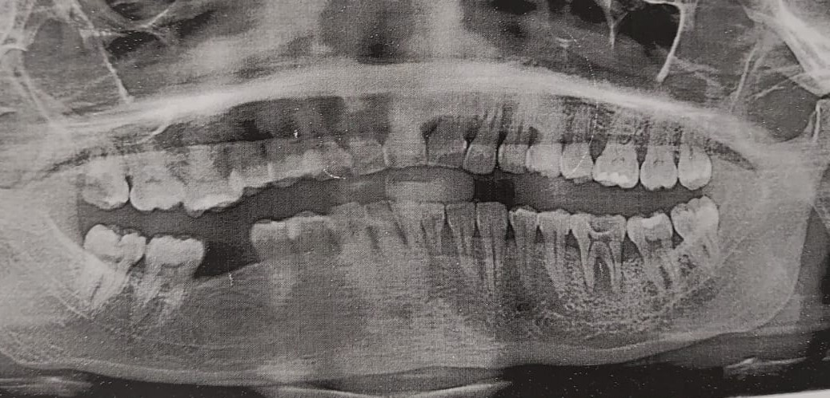
OPG

Slide 23
Final diagnosis:
Generalized Periodontitis stage III grade B.
Prognosis:
Overall: Fair
Individual: Poor irt 22,36
Fair irt 31,41,32,42,11,23,24,26

Slide 24
TREATMENT PLAN
Phase I: Patient education and motivation
Oral hygiene instructions
Scaling and root planning
Splinting irt 31, 32, 41, 42
Phase IV: Recall and maintenance for every 3 months

Slide 25
Phase II:
Advised Flap surgery.
Advised implant irt 46
Phase III:
Advised restorations irt 48
Advised RCT irt 36,22
Phase IV: Recall and maintenance for every 3 months

Slide 26
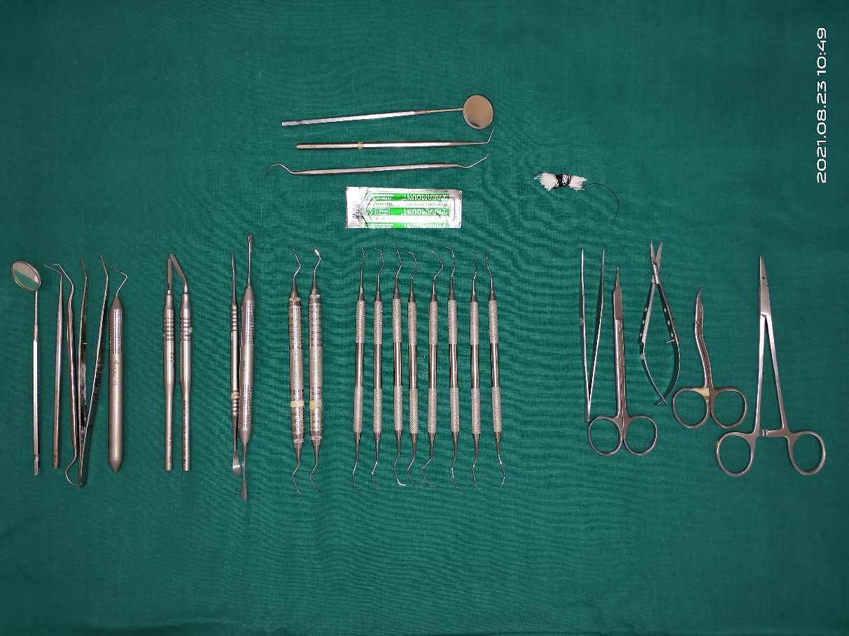
ARMAMENTARIUM

Slide 27
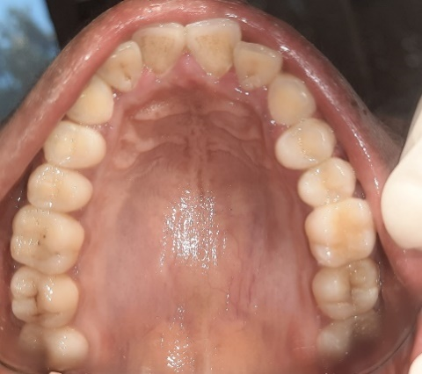
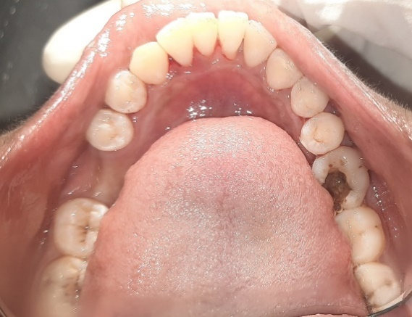
AFTER PHASE 1 THERAPY

Slide 28
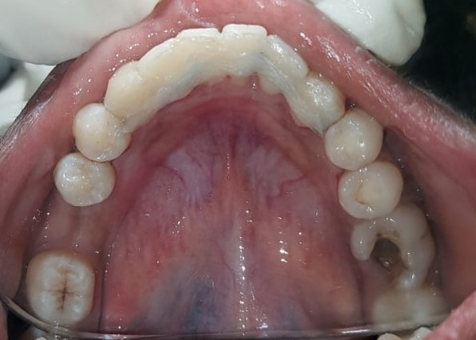
SPLINTING

Slide 29
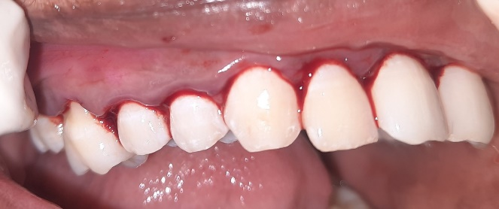
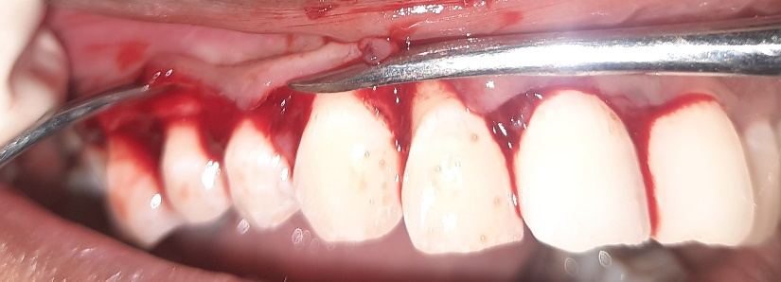
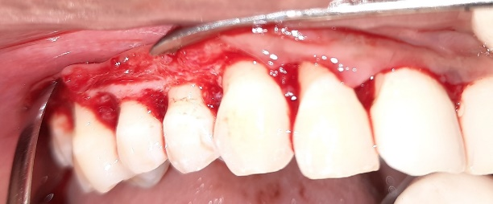
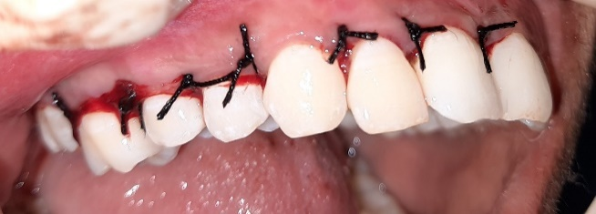
1ST QUADRANT
INCISIONS
REFLECTION
DEBRIDEMENT
SUTURING

Slide 30
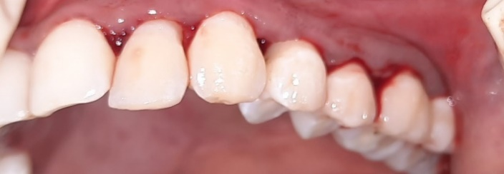
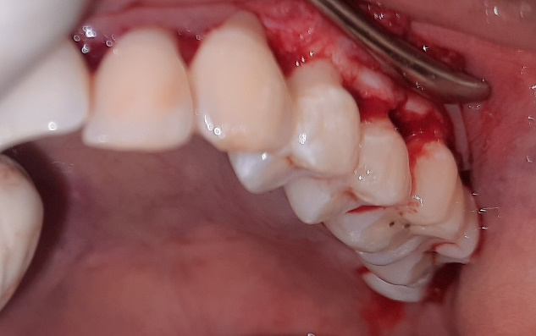
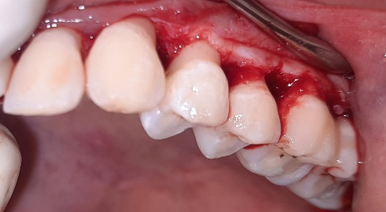
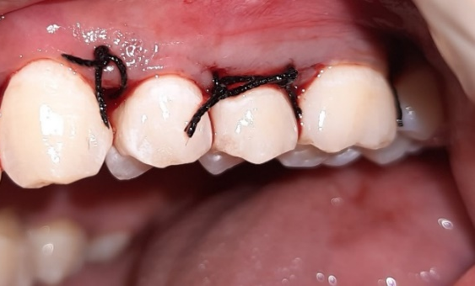
2ND QUADRANT
INCISIONS
REFLECTION
DEBRIDEMENT
SUTURING

Slide 31
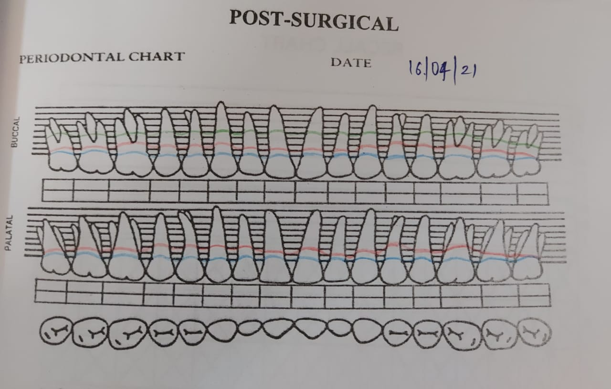
Post surgical charting

Slide 32
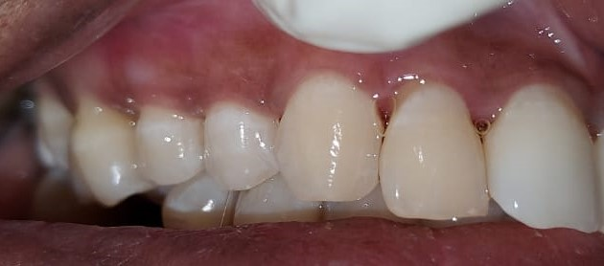
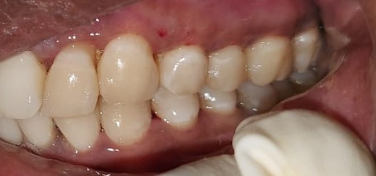
Post-operative phase(After 3 months)

